Slide 1
DATABASE DESIGN

Slide 2
What is database design
Database design is the process of creating a blueprint for how data will be stored, accessed, managed, and updated in a relational or non-relational database system. A well-designed database ensures:
Data is organized logically
Data integrity is maintained
Data is scalable and secure
Queries are efficient and reliable

Slide 3
Core Components of Database Design
Requirements Gathering
To understand what the system is supposed to do and what kind of data it will manage.
Key Activities:
a) Identify Stakeholders (System users (e.g., staff, customers)
b) Understand Business Rules and Processes - What is the system supposed to support?
Example: In a hospital system:
A doctor sees many patients.
Each visit is recorded with diagnosis and treatment.
Medication may be prescribed, and billing must be generated.

Slide 4
CONT: CONCEPTS IN DATABASE DESIGN
c) Define Data Requirements
What data should be collected? e.g., For patients: Name, Age, Address, Gender, Visit History
What are the entities (things you need to track)? e.g., Patients, Doctors, Visits, Prescriptions
d) Define Functional Requirements (CRUD Operations)
What needs to be:
Created (e.g., Register new patient)
Read (e.g., View medical history)
Updated (e.g., Change contact info)
Deleted (e.g., Remove erroneous records)

Slide 5
CONT: CONCEPTS IN DATABASE DESIGN
e) Define Volume & Performance Expectations
How many users?
How much data over time?
Any real-time performance needed?
f) Security & Compliance Needs
Are there fields requiring encryption?
Should data be anonymized or access-controlled?

Slide 6
2. Conceptual Design (ER Modeling)
This step transforms the business understanding into a visual data model using an Entity-Relationship Diagram (ERD).
An ER model represents:
Entities: Real-world objects or concepts e.g student, course,
Attributes: Characteristics of entities e.g student_id, name, email
Relationships: How entities relate to one another
Types:
One-to-One: One passport → one person
One-to-Many: One customer → many orders
Many-to-Many: Many students ↔ many courses

Slide 7
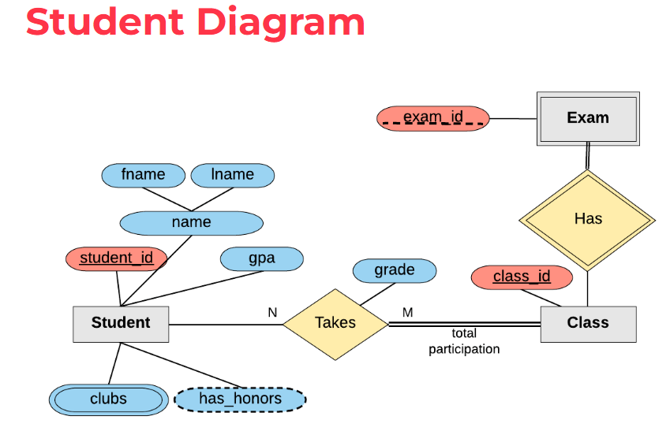
Entities (Rectangles)
Student
Class
Exam
Relationships (Diamonds)
Takes
A many-to-many relationship between student and class
Has
A one–to-many relationship from class to exam
Attribute Types (Ovals)
Red Ovals: Primary keys
Blue Ovals: Regular attributes
Dashed Ovals: optional attributes e.g has_honors

